Slide 1
FHIR Overview for Clinicians and Decision Makers
David Hay
New Orleans, January 2018

Slide 2

Who am I?
Name: David Hay
Company: Orion Health
Background:
Medical Doctor
Chair Emeritus of HL7 New Zealand
Co-chair FHIR Management Group
Product Strategist Orion Health
Blog: fhirblog.com
Tooling: clinFHIR.com

Slide 3
This presentation
Can be downloaded here:
https://github.com/FHIR/documents/raw/master/presentations/2018-01%20Tutorials/Jan2018_FHIR%20for%20Clinicians.pptx
Is licensed for use under the Creative Commons, specifically:
Creative Commons Attribution 3.0 Unported License
(Do with it as you wish, so long as you give credit)

Slide 4
Clinicians on FHIR
Clinicians testing FHIR resources
Apply to real scenarios
Feedback to spec
clinFHIR as tooling
This Friday

Slide 5
Outcomes…
Understand why FHIR happened
Advantages and uses of FHIR
Basics of FHIR
Know where to find information, and how to understand it
Able to participate knowledgeably in FHIR projects
Understand clinFHIR as an educational tool
Participate in Clinicians On FHIR (Friday)

Slide 6
A bit of history
Started 6 years ago
The fresh look
Right time, right place
JASON report
Since then..
Almost universal take up by Vendors
Massive interest from Providers
Implementations and projects world wide
Large, very active International community
Scope increased from just Interoperability
Notes:
Talk about scope

Slide 7
Benefits of FHIR
Clinician
Able to get more involved in system design
Faster, more timely access to more high quality data
Consumer
Better involvement with health care
Health Care Organization
Ability to innovate
Vendor
Familiar development environment
App marketplace

Slide 8
Basics of FHIR

Slide 9
What is FHIR
An HL7 Interoperability Standard
For sharing clinical information
2 main parts
Content Model (Resources)
Exchange Specification
Extending into
Clinical Knowledge
Decision Support
Quality Measures
Also being used for persistence
Supported by a large community

Slide 10
Timeline: Where does FHIR fit?
V2
1987
Start V3
1995
V3 CDA
2005
Fresh Look
2011
FHIR Release 3
2016
V2
V3
CDA
FHIR
1980
1990
2000
2010
2020
Notes:
FHIR version – 3

Slide 11
Overview of FHIR
Fast Healthcare Interoperability Resources (FHIR)
Consistent, simple to use content model (resources)
Controlled extensibility
Supports all paradigms of exchange
Real-time APIs
Documents, Messages & Operations
Designed with implementers in mind
Open Source, freely available
Detailed on-line, hyperlinked specification (hl7.org/fhir)
Freely available tooling, servers, libraries
Strong endorsement and support from vendors, providers and regulatory community (e.g. US - Project Argonaut, UK - INTEROpen.org)
Massive supporting community

Slide 12
Where can you use FHIR
V3
V2
FHIR
Application
FHIR
Integration Engine
PHR
FHIR
API Library
DataBase

Slide 13
Exchange Paradigms
REST
Documents
Messages
Services (Operations)

Slide 14


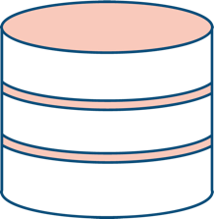


Sharing information – different paradigms
Message
FHIR
Repository
Document
REST

Slide 15
Sample clinical use cases
Direct exchange of structured and coded clinical data
Eg Discharge Summary, Progress Note, Patient sourced data
Real-time access to data
Mobile application
Referrals
Including directory infrastructure (Services, Providers…) and scheduling
Storage of clinical data
Other common pattern is interface
Clinical Decision Support / Quality metrics
Definition and Interface
CDS-Hooks

Slide 16
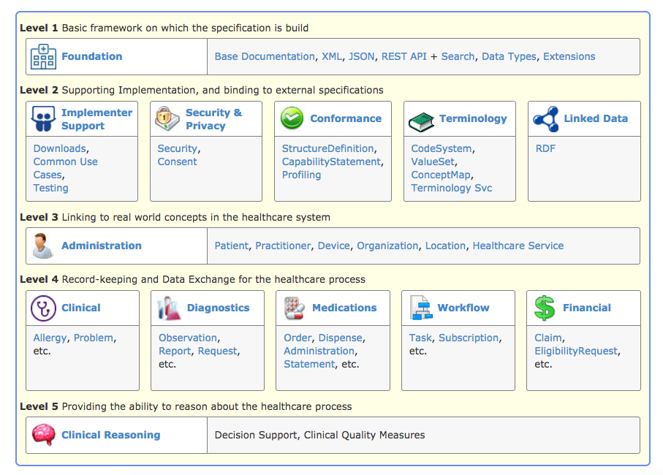
The specification
http://hl7.org/fhir/

Slide 17
Resources: What are they?
The Content Model
The Thing that is exchanged
Via REST ( FHIR Restful API), Messages, Documents
Informed by much past work inside & outside of HL7
HL7: version 2, version 3 (RIM), CDA
Other SDO: openEHR, CIMI, ISO 13606, IHE, DICOM

Slide 18
Resources: Type vs Instance
‘Type’ is the definition in the spec
Like a template
‘Instance’ is a ‘filled out’ type
Like a form (sort of)
Take Patient:
Patient type (in spec) is what can be recorded for a patient
Extensions are extra
An actual patient is a particular instance of the Patient type

Slide 19




Clinical Resource types
General
AllergyIntolerance
Condition (Problem)
Procedure
ClinicalImpression
FamilyMemberHistory
RiskAssessment
DetectedIssue
Care Provision
CarePlan
CareTeam
Goal
ReferralRequest
ProcedureRequest
NutritionOrder
VisionPrescription
Medication & Immunization
Medication
MedicationRequest
MedicationAdministration
MedicationDispense
MedicationStatement
Immunization
ImmunizationRecommendation
Diagnostics
Observation
DiagnosticReport
ProcedureRequest
Specimen
BodySite
ImagingStudy
Sequence
Notes:
Talk about Maturity model

Slide 20
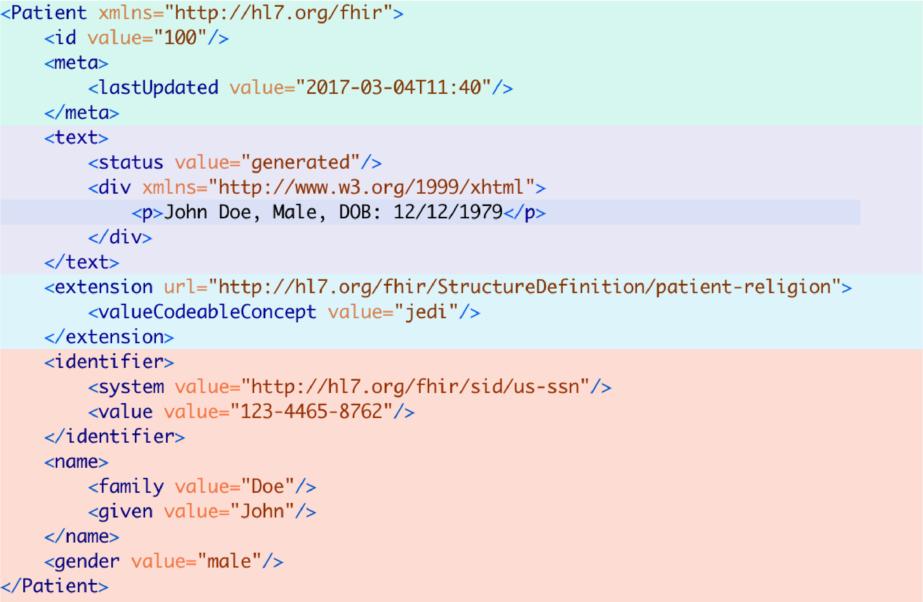
Resource instance example
Resource Identity & Metadata
Human Readable Summary
Extension with URL to definition
<valueString value=“jedi”/>
Structured Data:
MRN
Name
Gender
Birth Date
Provider
XML and JSON
Notes:
Explain what XML & Json are – eg different language

Slide 21
References between resources
Patient
Subject
Condition
Related Item
PROCEDURE
Report
Diagnostic report
Encounter
Performer
Encounter
Practitioner
Notes:
Names are element names ? Keep names…. ?? Introducte before scenario builder

Slide 22
Recording a consultation
12-year-old-boy First consultation
Complaining of pain in the right ear for 3 days with an elevated temperature. On examination, temperature 38°C and an inflamed right eardrum with no perforation. Diagnosis Otitis Media, and prescribed Amoxicillin 250mg 3 times per day for 7 days.
Follow up consultation
2 days later returned with an itchy skin rash. No breathing difficulties. On examination, urticarial rash on both arms. No evidence meningitis. Diagnosis of penicillin allergy. Antibiotics changes to Erythromycin 250mg 4 times per day for 10 days.
Patient
Encounter
Condition
Observation
Medication
Allergy Intolerance

Slide 23
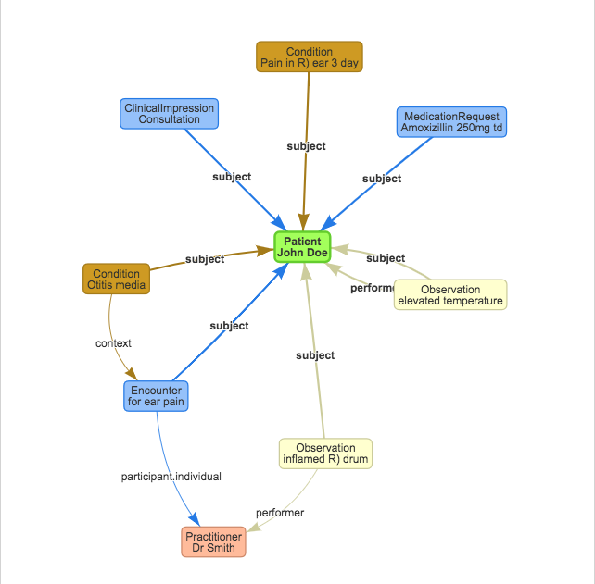
As linked resources
Using clinFHIR
Shows relationships between resource instances graphically
Uses ‘Instances’ of resource types
Scenario Builder tool
Don’t need detailed FHIR knowledge
but do need Resources Model or to be able to choose the correct resource types
Can also add data to instances
examples

Slide 24
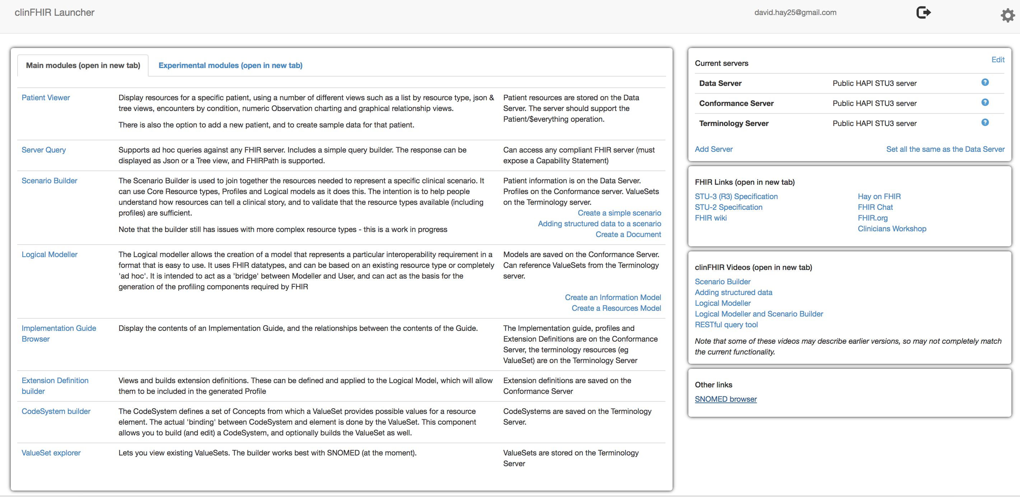
clinFHIR
Developed as training tool
Evolving!
What does clinFHIR do
View Patient data
Logical Modeler
Scenario Builder
ValueSet explorer
Extension Definition editor
Implementation Guide viewer
Clinfhir.com

Slide 25
clinFHIR: Server roles
Specific FHIR server roles
Data – patient related (clinical) and ‘reference’ (Practitioner, Organization)
Conformance – profile, extension Definition, NamingSystem
Terminology – ValueSet & Terminology operations
Patient and Data
Profiles
(Conformance)
Terminology
clinFHIR
Notes:
What is a conformance server…

Slide 26
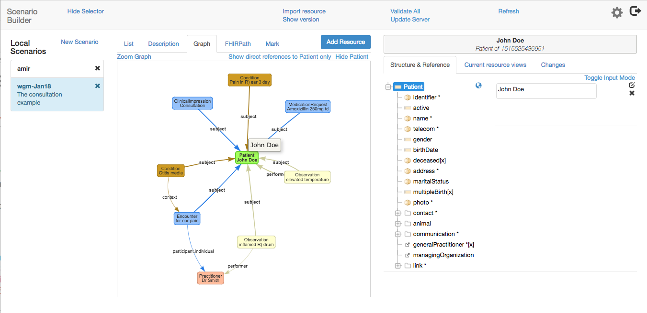
Scenario Builder
Shows relationships between resource instances graphically
Uses ‘Instances’ of resource types
Scenario Builder tool
Don’t need detailed FHIR knowledge
but do need Resources Model or to be able to choose the correct resource types
Can also add data to instances
examples

Slide 27

Demonstration
Building a scenario in clinFHIR
Part 1: Resources and References
Notes:
77532 – eve betterhalf – documents
Georgia taylor

Slide 28
Structured and coded data

Slide 29
Why have structured / coded data
Structured vs Coded
Value:
Greatly improves quality of exchange
‘semantic’ interoperability
Secondary uses
Decision Support
Analytics
Population Health
Reporting

Slide 30
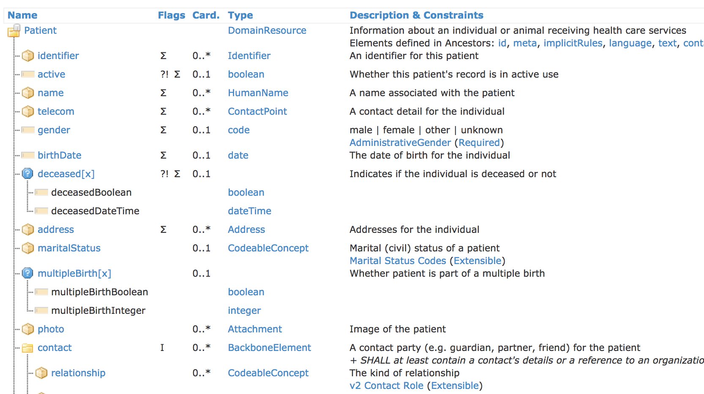
Resource type structure in the spec

Slide 31

Datatypes
What are datatypes
Datatypes in resource type definition
Backbone element
‘choice’ data types
Coded elements

Slide 32
Data types: Primitive
instant
time
date
dateTime
Value : xs : dataTime 0..1
Value : xs : Time 0..1
Value : xs:gYear [xs:gYearMonth | Time 0..1
Value : xs:gYear [xs:gYearMonth | xs:date | Time 0..1
decimal
Element
boolean
Value : xs : decimal 0..1
Extension : Extension 0..
value : xs:boolean 0..1
integer
string
uri
base64Binary
Value : xs : int 0..1
Value : xs :string 0..1
Value : xs :anyURI 0..1
Value : xs : base64Binary 0..1
unsignedint
positiveInt
code
id
oid
Based on w3c schema and ISO data types
Stick to the “80% rule” – only expose what most will use
Simplified

Slide 33
Data types: Complex
SampledData
origin: Quantity(SimpleQuantity) [1..1]
period: Decimal [1..1]
factor: Decimal [0..1]
lowerLimit: Decimal [0..1]
upperLimit: Decial [0..1]
dimensions: Positivelnt [1..1]
data: String [1..1]
Address
use: code [0..1] AddressUse!
type: code [0..1] AddressType!
text: string [0..1]
line: string [0..*]
city: string [0..1]
district: string [0..1]
state: string [0..1]
postalCode: string [0..1]
country: string [0..1]
period: Period 0...1
Attachment
contentType: Code [0..1] MimeType!
language: Code [0..1] CommonLanguages+
data: base64Binary [0..1]
url: uri [0..1]
size: unsignedInt [0..1]
hash: base64binary [0..1]
title: string [0..1]
creation: dateTime [0..1]
Coding
system: uri [0..1]
version: string [0..1]
code: code [0..1]
display: String [0..1]
userSelected: boolean [0..1]
Ratio
numerator: Quality [0..1]
denominator: Quantity [0..1]
CodeableConcept
coding: Coding [0..*]
text: String [0..1]
Quantity
value: decimal [0..1]
comparator: code [0..1] QuantityComparator!
units: string [0...1]
system: uri [0..1]
code: code [0..1]
ContactPoint
system: Code [0..1] ContactPointSystem!
value: String [0..1]
use: Code [0..1] ContactPointUse!
rank: PositiveInt [0...1]
period: Period [0..1]
Range
low: Quantity(SimpleQuantity) [0..1]
high: Quantity(SimpleQuantity) [0..1]
Element
extension: Extension 0..*
Timing
event: dataTime [0..*]
code: CodeableConcept [0..1] TimingAbbreviation?
HumanName
use: code [0..1] NameUse!
text: String [0..1]
family: String [0..*]
given: String [0..*]
prefix: String [0..*]
suffix: String [0..*]
period: Period [0..1]
Repeat
bounds[x]: Type [0..1] Duration|Range|Period
dount: Integer [0..1]
dountMax: integer [0..1]
duration: decimal [0..1]
durationMax: decimal [0..1]
durationUnit: code [0..1] UnitsOfTime!
frequency: integer [0..1]
frequencyMax: integer [0..1]
period: decimal [0..1]
periodMax: [0..1]
periodUnit: code [0..1] UnitsOfTime
dayOfWeek: code [0..*] DaysOfWeek!
timeOfDay: time [0..*]
when: Code [0..*] EventTiming!
offset: unsginedInt [0..1]
Signature
type:Coding [1..*] Signature Type?
when: Instant [1..1]
who[x]: Type [1..1] uri | Reference(Practitioner|Related person|PatientDevice|Organization)
onBehalfOf[x]: Type [0..1] uri|Reference(Practitioner|RelatedPerson|Pateint|Device|Organization)
contentType: code [0..1] MimeType!
blob: base64Binary [0..1]
repeat
[0..1]
Identifier
use: code [0..1] IdentifierUse!
type: CodeableConcept [0..1] IdentifierType+
system: uri [0..1]
value: String [0..1]
period: Period [0..1]
assigner: Reference [0..1] Organization
Annotation
author[x]: Type [0..1] Reference(Practitioner|Patient| RelatedPerson)|string
Time: dateTime [0..1]
Text: string [1..1]
Period
start: dateTime [0..1]
end: dateTime [0..1]

Slide 34
Coded datatypes
Code: "status" : "confirmed"
Coding: { "system": "http://www.nlm.nih.gov/research/umls/rxnorm", "code": "C3214954", "display": "cashew nut allergenic extract Injectable" }
CodeableConcept: { "coding": [{ "system": "http://snomed.info/sct", "code": "39579001", "display": "Anaphylactic reaction“ }], "text" : "Anaphylaxis" }

Slide 35
ValueSet
{
"resourceType": "ValueSet",
"compose": {
"include": [
{
"system": http://snomed.info/sct",
"filter": [
{
"property": "concept",
"op": "is-a",
"value": "404684003"
}
]
}
]
}
}
A context specific subset of one or more Code Systems
Promotes consistency between applications
Key component of Terminology
Also CodeSystem
Start thinking about in Information model
Used by a number of services (Operations)
$expand

Slide 36
Terminology Sub-system
Code System:
Defines a set of concepts with a coherent meaning Code Display
Definition
SNOMED CT / LOINC / RxNORM
ICPC, MIMS + 100s more
ICD-X+
A drug formulary
Custom

Slide 37
Terminology Sub-system
Code System:
Defines a set of concepts with a coherent meaning Code Display
Definition
Value Set:
A selection of a set of codes for use in a particular context
Selects

Slide 38
Terminology Sub-system
Code System:
Defines a set of concepts with a coherent meaning Code Display
Definition
Value Set:
A selection of a set of codes for use in a particular context
Element Definition: Type and Value set reference
Selects
Binds
Binding:
Connection between element and ValueSet
Strength determines if can change

Slide 39
Terminology Sub-system
Definition
Code System:
Defines a set of concepts with a coherent meaning Code Display
Definition
Value Set:
A selection of a set of codes for use in a particular context
Element Definition: Type and Value set reference
Selects
Binds
Instance
Conforms
Element: code/ Coding/ CodeableConcept
Refers to

Slide 40
Demonstration
Building a scenario in clinFHIR
Part 2: Adding structured and coded data
Notes:
77532 – eve betterhalf – documents
Georgia taylor

Slide 41
Adapting FHIR to your needs: Profiling
Many different contexts in healthcare, but want a single set of Resources
The 80% rule
Need to be able to describe ‘usage of FHIR’ based on context
Allow for these usage statements to:
Authored in a structured manner
Published in a registry & Discoverable
Used as the basis for validation, code, report and UI generation.

Slide 42
More on Profiling
3 main aspects:
Constraining a resource - remove element, change multiplicity fix values
Change coded element binding
Adding a new element (an extension)
Modifier Extensions
Profiling adapts FHIR for specific scenarios
A Statement of Use

Slide 43
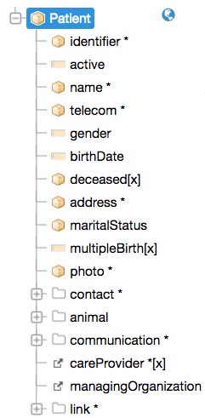
For example…
Require that the identifier uses a national identifier – and is required
Limit names to just 1 (instead of 0..*)
Change maritalStatus to another set of codes that extends the one from HL7 international
Don’t support photo
Add an extension to support ethnicity

Slide 44
Demo
View a profile
http://hl7.org/fhir/us/core/StructureDefinition-us-core-patient.html
Notes:
77532 – eve betterhalf – documents
Georgia taylor

Slide 45
General considerations
Tooling
Forge (https://fhir.furore.com/forge/ )
Simplifier Registry (https://registry.fhir.org/)
clinFHIR (clinfhir.com)
Governance

Slide 46
Logical Models
To help define requirements
‘Information Model’
As a step to profiling

Slide 47
Demo
Logical Modeler
Notes:
77532 – eve betterhalf – documents
Georgia taylor

Slide 48
Paradigms revisited
REST
Documents
Messages
Services (Operations)

Slide 49
Bundles
Bundle Resource
Container resource
Types of Bundle
Searchset
Transaction
Document
Message
…
Patient Resource
List Resource
Condition Resource

Slide 50
Document paradigm
Summary at a point in time
Part of record
Very common
Discharge Summary
Referral letter
Progress Note
A collection of resources
Equivalent to CDA
CDA on FHIR

Slide 51
Documents - are bundles
Bundle
Patient
Composition
Subject
Author
Section 1
Section 2
Practitioner
List
Observation Resource
Device
List
Condition
Condition
Note: Most resources have a reference to Patient

Slide 52
Composition resource
Document header
Document type
References to Patient, Author, Custodian …
Equivalent to:
CDA header
IHE XDS metadata
Sections (headings)
Contents are text and structured/coded data
Rules for rendering
Can be profiled (ie specific document types)

Slide 53
Demo
Convert the record into a Progress Note
Notes:
77532 – eve betterhalf – documents
Georgia taylor

Slide 54
Implementation Guide
Brings all the artifacts together for a specific reason
Eg US Core, UK CareConnect, CCDA on FHIR
Registry at FHIR.org (http://www.fhir.org/guides/registry)
Includes
StructureDefinition (Profiles and Extension Definitions)
ValueSets & other Terminology related
Examples
Documentation

Slide 55
Demo
View Implementation Guide at http://www.fhir.org/guides/registry
Notes:
77532 – eve betterhalf – documents
Georgia taylor

Slide 56
Associated Standards
SMART
CDS-Hooks

Slide 57




Security
FHIR is not a security standard
Leverages existing standards – for example
HTTPS
OAuth2
SMART
Support in the specification
Security tags (metadata)
Specialized resources
Provenance
AuditEvent
More detail
http://hl7.org/fhir/security.html

Slide 58
Wrapping up: Doing this for real
FHIR is a game changer…
But not a silver bullet.
Beware the Gartner hype cycle!
Managing Expectations
Sensitivity of data
Complexity of environment
Analogy of building house
All this is the concept plan…

Slide 59
More information
From HL7
http://hl7.org/fhir/index.html
wiki.hl7.org/index.php?title=FHIR
Community
http://www.fhir.org/
https://chat.fhir.org/
List server (fhir@lists.hl7.org )
Stack Overflow (tag FHIR)
Blogs
www.healthintersections.com.au/
https://fhirblog.com/
https://thefhirplace.com/
https://brianpos.com
Libraries
Java (http://hapifhir.io/)
C# (NuGet HL7.FHIR)Tooling
Forge (http://fhir.furore.com/Forge)
Tooling
Forge (http://fhir.furore.com/Forge)
http://clinfhir.com/
Test servers
http://wiki.hl7.org/index.php?title=Publicly_Available_FHIR_Servers_for_testing
https://fhirblog.com/2016/10/19/setting-up-your-own-fhir-server-for-profiling/

